Slide 1
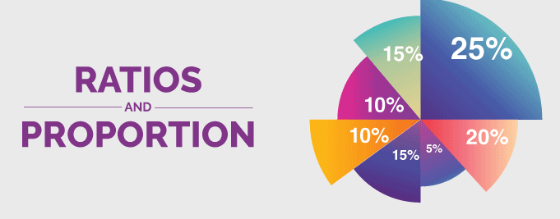
RATIO AND PROPORTION

Slide 3
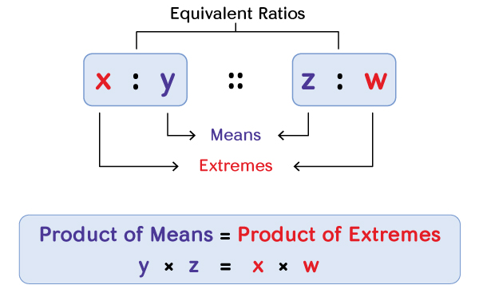
Note:- Product of extremes = Product of means

Slide 4
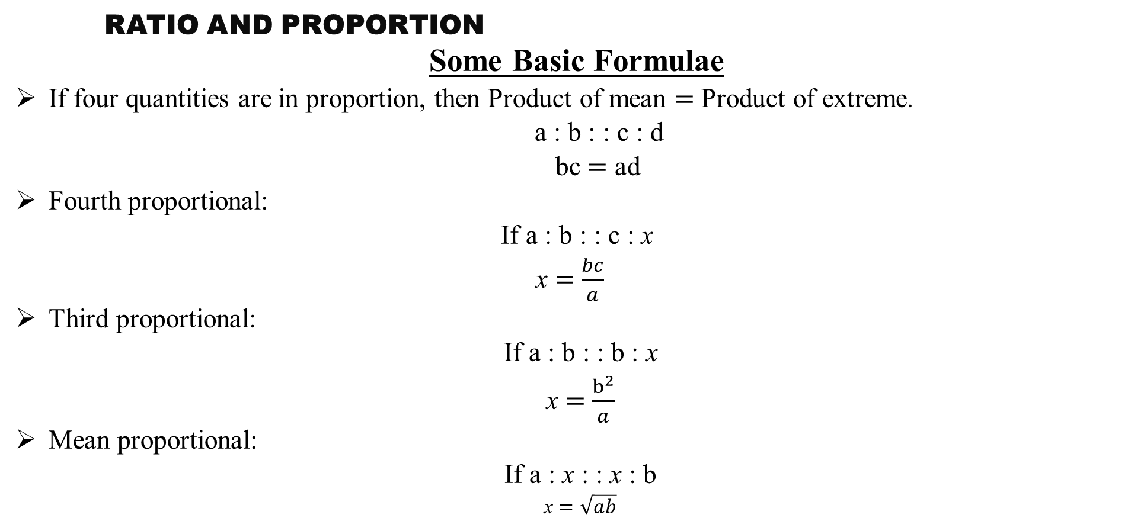
RATIO AND PROPORTION
Some Basic Formulae
If four quantities are in proportion, then Product of mean $=$ Product of extreme.
a : b : : c : d
bc $=$ ad
Fourth proportional:
If a : b : : c : x
x $=$ $\frac{bc}{a}$
Third proportional:
If a : b : : b : x
x $=$ $\frac{b^{2}}{a}$
Mean proportional:
If a : x : : x : b
x $=$ $\sqrt{ab}$

Slide 5
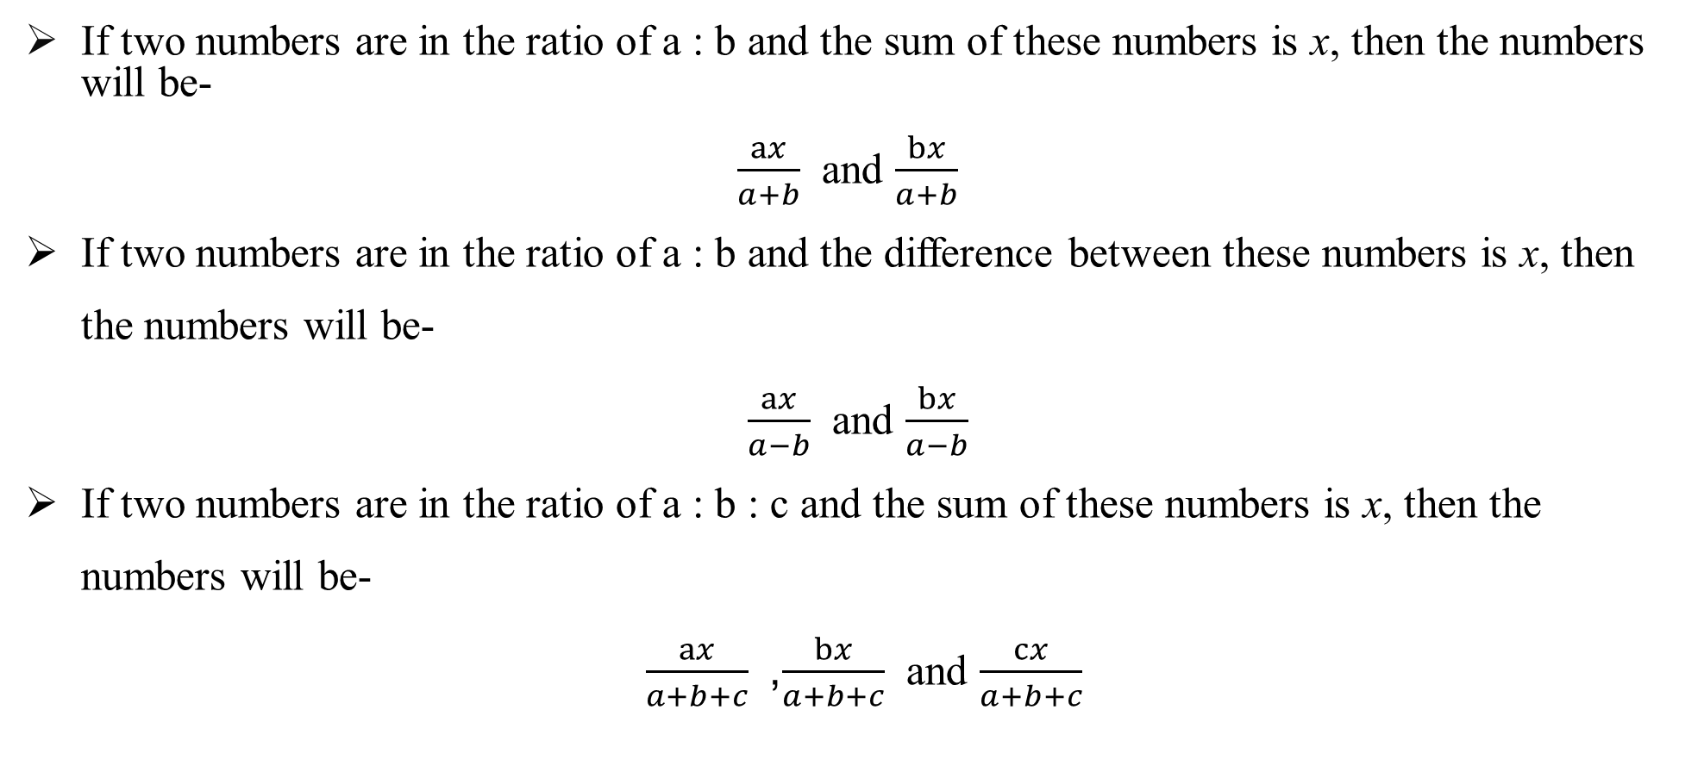
If two numbers are in the ratio of a : b and the sum of these numbers is x, then the numbers will be-
$\frac{ax}{a+b}$ and $\frac{bx}{a+b}$
If two numbers are in the ratio of a : b and the difference between these numbers is x, then the numbers will be-
$\frac{ax}{a−b}$ and $\frac{bx}{a−b}$
If two numbers are in the ratio of a : b : c and the sum of these numbers is x, then the numbers will be-
$\frac{ax}{a+b+c}$, $\frac{bx}{a+b+c}$ and $\frac{cx}{a+b+c}$

Slide 6
RATIO AND PROPORTION
RATIO:-
A ratio is a comparison of two or more quantities of similar type. The ratio of a and b is written as .
In the ratio a : b, a and b are called the terms of the ratio where ‘a’ is the antecedent and ‘b’ is the consequent.
Important Properties of Proportion

Slide 7
RATIO AND PROPORTION
Properties of Ratio:-
In a ratio, the quantities which must be compared must be of the same kind, i.e. they must be expressed in the same units.
The ratio of two quantities determines how many times of one quantity is contained by the other.
The order of the terms in a ratio ʻa : bʼ is very important. Since 4 : 5 is different from 5 : 4.
a²:b² is a duplicate ratio
√a:√b is the sub-duplicate ratio
a³:b³ is a triplicate ratio

Slide 8
RATIO AND PROPORTION
Definition of Proportion:-
Proportion is an equation that defines that the two given ratios are equivalent to each other. In other words, the proportion states the equality of the two fractions or the ratios. In proportion, if two sets of given numbers are increasing or decreasing in the same ratio, then the ratios are said to be directly proportional to each other.

Slide 9
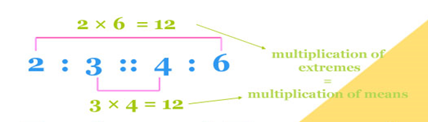
RATIO AND PROPORTION
Now, let us assume that, in proportion, the two ratios are a:b & c:d. The two terms ‘b’ and ‘c’ are called ‘means or mean term,’ whereas the terms ‘a’ and ‘d’ are known as ‘extremes or extreme terms.’
a/b = c/d or a : b :: c : d
Note:- Product of extremes = Product of means

Slide 10
RATIO AND PROPORTION
Important Properties of Proportion
The following are the important properties of proportion:
Addendo – If a : b = c : d, then a + c : b + d
Subtrahendo – If a : b = c : d, then a – c : b – d
Dividendo – If a : b = c : d, then a – b : b = c – d : d
Componendo – If a : b = c : d, then a + b : b = c+d : d
Alternendo – If a : b = c : d, then a : c = b: d
Invertendo – If a : b = c : d, then b : a = d : c
Componendo and dividendo – If a : b = c : d, then a + b : a – b = c + d : c – d

Slide 11
RATIO AND PROPORTION
Difference Between Ratio and Proportion
To understand the concept of ratio and proportion, go through the difference between ratio and proportion given here.
S.No | Ratio | Proportion
1 | The ratio is used to compare the size of two things with the same unit | The proportion is used to express the relation of two ratios
2 | It is expressed using a colon (:), slash (/) | It is expressed using the double colon (::) or equal to the symbol (=)
3 | It is an expression | It is an equation
4 | Keyword to identify ratio in a problem is “to every” | Keyword to identify proportion in a problem is “out of”

Slide 12
RATIO AND PROPORTION
Dividing a number in the given Ratio:-
Let ‘A’ be the number. The ratio given is a1 : a2. Here ‘A’ is to be divided in the ratio a1 : a2. It implies that A is divided in two parts such that value of first part : value of second part = a1 : a2.
Therefore, first part = a1/(a1 +a2)
second part = a2/(a1 +a2)
Note:
These relations are also true when we divide a number into more than two ratios (i.e. into more than two parts).

Slide 13
RATIO AND PROPORTION
Q 1. Find a fourth proportional to the numbers 6, 8, 9.
12
(2) 7
(3) 5
(4) 14
(5) None of these

Slide 14
RATIO AND PROPORTION
Q 1. Find a fourth proportional to the numbers 6, 8, 9.
12
(2) 7
(3) 5
(4) 14
(5) None of these

Slide 15
RATIO AND PROPORTION
Q 2. Find a third proportional to the numbers 3 and 6.
21
(2) 1.5
(3) 18
(4) 12
(5) None of these

Slide 16
RATIO AND PROPORTION
Q 2. Find a third proportional to the numbers 3 and 6.
21
(2) 1.5
(3) 18
(4) 12
(5) None of these

Slide 17
RATIO AND PROPORTION
Q 3. Two numbers are in the ratio of 9 : 11. If sum of these two numbers is 660, find the difference between the numbers.
66
(2) 56
(3) 46
(4) 76
(5) None of these

Slide 18
RATIO AND PROPORTION
Q 3. Two numbers are in the ratio of 9 : 11. If sum of these two numbers is 660, find the difference between the numbers.
66
(2) 56
(3) 46
(4) 76
(5) None of these

Slide 19
RATIO AND PROPORTION
Q 4. A bag contains rupee, 50-paise and 25-paise coins in the ratio 5 : 7 : 9. If the total amount in the bag is 430, find the number of coins of each kind.
200, 280, 360
(2) 280, 200, 360
(3) 360, 280, 200
(4) 360, 200, 280
(5) None of these

Slide 20
RATIO AND PROPORTION
Q 4. A bag contains rupee, 50-paise and 25-paise coins in the ratio 5 : 7 : 9. If the total amount in the bag is 430, find the number of coins of each kind.
200, 280, 360
(2) 280, 200, 360
(3) 360, 280, 200
(4) 360, 200, 280
(5) None of these

Slide 21
RATIO AND PROPORTION
Q 5. A bag contains an equal number of 50-paise, 25-paise, 20 paise and 5-paise coins, respectively. If the total value is 40, how many coins of each type are there?
40
(2) 25
(3) 30
(4) 20
(5) None of these

Slide 22
RATIO AND PROPORTION
Q 5. A bag contains an equal number of 50-paise, 25-paise, 20 paise and 5-paise coins, respectively. If the total value is 40, how many coins of each type are there?
40
(2) 25
(3) 30
(4) 20
(5) None of these

Slide 23
RATIO AND PROPORTION
Q 6. One man adds 6 liters of water to 11 liters of milk and another 9 liters of water to 8 liters of milk. What is the ratio of the strengths of milk in the two mixtures?
2 : 3
(2) 3 : 2
(3) 11 : 8
(4) 8 : 11
(5) None of these

Slide 24
RATIO AND PROPORTION
Q 6. One man adds 6 liters of water to 11 liters of milk and another 9 liters of water to 8 liters of milk. What is the ratio of the strengths of milk in the two mixtures?
2 : 3
(2) 3 : 2
(3) 11 : 8
(4) 8 : 11
(5) None of these

Slide 25
RATIO AND PROPORTION
Q 7. Two vessels contain equal quantity of mixtures of milk and water in the ratio 8 : 9 and 12 : 5, respectively. Both the mixtures are now mixed thoroughly. Find the ratio of milk to water in the new mixture so obtained.
7 : 10
(2) 13 : 21
(3) 21 : 13
(4) 10 : 7
(5) None of these

Slide 26
RATIO AND PROPORTION
Q 7. Two vessels contain equal quantity of mixtures of milk and water in the ratio 8 : 9 and 12 : 5, respectively. Both the mixtures are now mixed thoroughly. Find the ratio of milk to water in the new mixture so obtained.
7 : 10
(2) 13 : 21
(3) 21 : 13
(4) 10 : 7
(5) None of these

Slide 27
RATIO AND PROPORTION
Q 8. The contents of two vessels containing water and milk are in the ratio 2 : 3 and 4 : 5 are mixed in the ratio 1 : 2. The resulting mixture will have water and milk in the ratio________ .
77 : 58
(2) 58 : 77
(3) 68 : 77
(4) 77 : 68
(5) None of these

Slide 28
RATIO AND PROPORTION
Q 8. The contents of two vessels containing water and milk are in the ratio 2 : 3 and 4 : 5 are mixed in the ratio 1 : 2. The resulting mixture will have water and milk in the ratio________ .
77 : 58
(2) 58 : 77
(3) 68 : 77
(4) 77 : 68
(5) None of these

Slide 29
RATIO AND PROPORTION
Q 9. The contents of two vessels containing water and milk are in the ratio 3 : 4 and 5 : 4 are mixed in the ratio 1 : 4. The resulting mixture will have water and milk in the ratio_______ .
184 : 176
(2) 167 : 184
(3) 167 : 148
(4) 148 : 167
(5) None of these

Slide 30
RATIO AND PROPORTION
Q 9. The contents of two vessels containing water and milk are in the ratio 3 : 4 and 5 : 4 are mixed in the ratio 1 : 4. The resulting mixture will have water and milk in the ratio_______ .
184 : 176
(2) 167 : 184
(3) 167 : 148
(4) 148 : 167
(5) None of these

Slide 31
RATIO AND PROPORTION
Q 10. An amount of 950 is distributed among A, B and C in the ratio of 5 : 11 : 3, what is the difference between the share of B and A?
550
(2) 250
(3) 200
(4) 300
(5) None of these

Slide 32
RATIO AND PROPORTION
Q 10. An amount of 950 is distributed among A, B and C in the ratio of 5 : 11 : 3, what is the difference between the share of B and A?
550
(2) 250
(3) 200
(4) 300
(5) None of these

Slide 33
RATIO AND PROPORTION
Q 11. A and B are two alloys of gold and copper prepared by mixing metals in proportions 7 : 2 and 7 : 11, respectively. If equal quantities of alloys are melted to form a third alloy C, the proportion of gold and copper in C will be :
5 : 9
(2) 5 : 7
(3) 7 : 5
(4) 9 : 5
(5) None of these

Slide 34
RATIO AND PROPORTION
Q 11. A and B are two alloys of gold and copper prepared by mixing metals in proportions 7 : 2 and 7 : 11, respectively. If equal quantities of alloys are melted to form a third alloy C, the proportion of gold and copper in C will be :
5 : 9
(2) 5 : 7
(3) 7 : 5
(4) 9 : 5
(5) None of these

Slide 35
RATIO AND PROPORTION
Q 12. The sum of three numbers is 105. If the ratio between the first and second be 2 : 3 and that between the second and third be 4 : 5, then find the second number.
35
(2) 24
(3) 36
(4) 45
(5) None of these

Slide 36
RATIO AND PROPORTION
Q 12. The sum of three numbers is 105. If the ratio between the first and second be 2 : 3 and that between the second and third be 4 : 5, then find the second number.
35
(2) 24
(3) 36
(4) 45
(5) None of these

Slide 37
RATIO AND PROPORTION
Q 13. If A : B = 3 : 4, B : C = 5 : 7 and C : D = 3 : 5, then find A : B : C : D.
9 : 21 : 12 : 28
(2) 45 : 60 : 84 : 140
(3) 9 : 12 : 28 : 21
(4) 9 : 12 : 21 : 82
(5) None of these

Slide 38
RATIO AND PROPORTION
Q 13. If A : B = 3 : 4, B : C = 5 : 7 and C : D = 3 : 5, then find A : B : C : D.
9 : 21 : 12 : 28
(2) 45 : 60 : 84 : 140
(3) 9 : 12 : 28 : 21
(4) 9 : 12 : 21 : 82
(5) None of these

Slide 39
RATIO AND PROPORTION
Q 14. A hound pursues a hare and takes 6 leaps for every 7 leaps of the hare, but 5 leaps of the hound are equal to 6 leaps of the hare. Compare the rates of the hound and the hare.
36 : 35
(2) 35 : 34
(3) 34 : 33
(4) 31 : 32
(5) None of these

Slide 40
RATIO AND PROPORTION
Q 14. A hound pursues a hare and takes 6 leaps for every 7 leaps of the hare, but 5 leaps of the hound are equal to 6 leaps of the hare. Compare the rates of the hound and the hare.
36 : 35
(2) 35 : 34
(3) 34 : 33
(4) 31 : 32
(5) None of these

Slide 41
RATIO AND PROPORTION
Q 15. In 28 liters mixture of milk and water the ratio of milk and water is 5 : 2. How much water should be added in the mixture so that the ratio of milk to water becomes 2 : 5?
42 liters
(2) 32 liters
(3) 24 liters
(4) 39 liters
(5) None of these

Slide 42
RATIO AND PROPORTION
Q 15. In 28 liters mixture of milk and water the ratio of milk and water is 5 : 2. How much water should be added in the mixture so that the ratio of milk to water becomes 2 : 5?
42 liters
(2) 32 liters
(3) 24 liters
(4) 39 liters
(5) None of these

Slide 43
RATIO AND PROPORTION
Q 16. A mixture contains milk and water in the ratio of 9 : 4. On adding 4 liters of water, the ratio of milk to water becomes 3 : 2. Find the total quantity of the original mixture.
26 liters
(2) 18 liters
(3) 10 liters
(4) 30 liters
(5) None of these

Slide 44
RATIO AND PROPORTION
Q 16. A mixture contains milk and water in the ratio of 9 : 4. On adding 4 liters of water, the ratio of milk to water becomes 3 : 2. Find the total quantity of the original mixture.
26 liters
(2) 18 liters
(3) 10 liters
(4) 30 liters
(5) None of these

Slide 45
RATIO AND PROPORTION
Q 17. The ratio between two numbers is 15 : 7. If each number be decreased by 2, the ratio becomes 7 : 3. Find the numbers.
15, 7
(2) 30, 14
(3) 45, 21
(4) 60, 28
(5) None of these

Slide 46
RATIO AND PROPORTION
Q 17. The ratio between two numbers is 15 : 7. If each number be decreased by 2, the ratio becomes 7 : 3. Find the numbers.
15, 7
(2) 30, 14
(3) 45, 21
(4) 60, 28
(5) None of these

Slide 47
RATIO AND PROPORTION
Q 18. The incomes of A and B are in the ratio 9 : 4 and their expenditures are in the ratio 7 : 3. If each saves 2000, what are their incomes?
90000, 4000
(2) 27000, 12000
(3) 72000, 16000
(4) 72000, 32000
(5) None of these

Slide 48
RATIO AND PROPORTION
Q 18. The incomes of A and B are in the ratio 9 : 4 and their expenditures are in the ratio 7 : 3. If each saves 2000, what are their incomes?
90000, 4000
(2) 27000, 12000
(3) 72000, 16000
(4) 72000, 32000
(5) None of these

Slide 49
RATIO AND PROPORTION
Q 19. Find the number which, when added to the terms of the ratio 13 : 28 makes it equal to the ratio 1 : 2.
4
(2) 3
(3) 2
(4) 1
(5) None of these

Slide 50
RATIO AND PROPORTION
Q 19. Find the number which, when added to the terms of the ratio 13 : 28 makes it equal to the ratio 1 : 2.
4
(2) 3
(3) 2
(4) 1
(5) None of these

Slide 51
RATIO AND PROPORTION
Q 20. Find the number which, when subtracted from the terms of the ratio 11 : 25 makes it equal to the ratio 4 : 11.
4
(2) 3
(3) 2
(4) 1
(5) None of these

Slide 52
RATIO AND PROPORTION
Q 20. Find the number which, when subtracted from the terms of the ratio 11 : 25 makes it equal to the ratio 4 : 11.
4
(2) 3
(3) 2
(4) 1
(5) None of these

Slide 53
RATIO AND PROPORTION
Q 21. A bucket contains a mixture of two liquids A and B in the proportion 5 : 3. If 16 liters of the mixture is replaced by 16 liters of liquid B, then the ratio of the two liquids becomes 3 : 5. How much of the liquid B was there in the bucket?
25 liters
(2) 15 liters
(3) 18 liters
(4) 24 liters
(5) None of these

Slide 54
RATIO AND PROPORTION
Q 21. A bucket contains a mixture of two liquids A and B in the proportion 5 : 3. If 16 liters of the mixture is replaced by 16 liters of liquid B, then the ratio of the two liquids becomes 3 : 5. How much of the liquid B was there in the bucket?
25 liters
(2) 15 liters
(3) 18 liters
(4) 24 liters
(5) None of these

Slide 55
RATIO AND PROPORTION
Q 22. A bucket contains a mixture of two liquids A and B in the proportion 6 : 5. If 33 liters of the mixture is replaced by 33 liters of liquid B, then the ratio of the two liquids becomes 3 : 4. How much of the liquid A was there in the bucket?
84 liters
(2) 48 liters
(3) 70 liters
(4) 64 liters
(5) None of these

Slide 56
RATIO AND PROPORTION
Q 22. A bucket contains a mixture of two liquids A and B in the proportion 6 : 5. If 33 liters of the mixture is replaced by 33 liters of liquid B, then the ratio of the two liquids becomes 3 : 4. How much of the liquid A was there in the bucket?
84 liters
(2) 48 liters
(3) 70 liters
(4) 64 liters
(5) None of these

Slide 57
RATIO AND PROPORTION
Q 23. An employer reduces the number of his employees in the ratio 9 : 4 and increases their wages in the ratio 2 : 5. State whether his bill of total wages increases or decreases, and in what ratio?
Decrease, 10 : 9
(2) Increase, 10 : 9
(3) Decrease 9 : 11
(4) Increase, 9 : 10
(5) None of these

Slide 58
RATIO AND PROPORTION
Q 23. An employer reduces the number of his employees in the ratio 9 : 4 and increases their wages in the ratio 2 : 5. State whether his bill of total wages increases or decreases, and in what ratio?
Decrease, 10 : 9
(2) Increase, 10 : 9
(3) Decrease 9 : 11
(4) Increase, 9 : 10
(5) None of these

Slide 59
RATIO AND PROPORTION
Q 24. Two candles of the same height are lighted at the same time. The first is consumed in 7 hours and the second in 6 hours. If each candle burns at a constant rate, in how many hours after being lighted, the ratio between the first and second candles becomes 3 : 1.
5 hours 36 minutes
(2) 5 hours
(3) 5 hours 60 minutes
(4) 6 hours
(5) None of these

Slide 60
RATIO AND PROPORTION
Q 24. Two candles of the same height are lighted at the same time. The first is consumed in 7 hours and the second in 6 hours. If each candle burns at a constant rate, in how many hours after being lighted, the ratio between the first and second candles becomes 3 : 1.
5 hours 36 minutes
(2) 5 hours
(3) 5 hours 60 minutes
(4) 6 hours
(5) None of these

Slide 61
RATIO AND PROPORTION
Q 25. Divide 680 among A, B and C such that A gets 2/3 of what B gets and B gets 1/4th of what C gets. What is C’s share?
280
(2) 380
(3) 480
(4) 120
(5) None of these

Slide 62
RATIO AND PROPORTION
Q 25. Divide 680 among A, B and C such that A gets 2/3 of what B gets and B gets 1/4th of what C gets. What is C’s share?
280
(2) 380
(3) 480
(4) 120
(5) None of these

Slide 63
RATIO AND PROPORTION
Q 26. When 50% of one number is added to a second number, the second number increases to its four-thirds. What is the ratio between the first number and the second number?
3 : 2
(2) 3 : 4
(3) 2 : 3
(4) Data inadequate
(5) None of these

Slide 64
RATIO AND PROPORTION
Q 26. When 50% of one number is added to a second number, the second number increases to its four-thirds. What is the ratio between the first number and the second number?
3 : 2
(2) 3 : 4
(3) 2 : 3
(4) Data inadequate
(5) None of these

Slide 65
RATIO AND PROPORTION
Q 27. 600 has been divided among A, B and C in such a way that 40 more than (2/5) of A’s share, 20 more than (2/7) of B’s share, 10 more than (9/17) of C’s share, are all equal. A’s share is :
280
(2) 170
(3) 150
(4) 200
(5) None of these

Slide 66
RATIO AND PROPORTION
Q 27. 600 has been divided among A, B and C in such a way that 40 more than (2/5) of A’s share, 20 more than (2/7) of B’s share, 10 more than (9/17) of C’s share, are all equal. A’s share is :
280
(2) 170
(3) 150
(4) 200
(5) None of these

Slide 67
RATIO AND PROPORTION
Q 28. One year ago, the ratio between Laxman’s and Gopal’s salary was 3 : 4. The individual ratios between their last years and this year’s salaries are 4 : 5 and 2 : 3, respectively. At present the total of their salary is 4160. The salary of Laxman now, is–
1600
(2) 2560
(3) 1040
(4) 3120
(5) None of these

Slide 68
RATIO AND PROPORTION
Q 28. One year ago, the ratio between Laxman’s and Gopal’s salary was 3 : 4. The individual ratios between their last years and this year’s salaries are 4 : 5 and 2 : 3, respectively. At present the total of their salary is 4160. The salary of Laxman now, is–
1600
(2) 2560
(3) 1040
(4) 3120
(5) None of these

Slide 69
THANK YOU

